Slide 1
HEART DISEASE PREDICTION USING MACHINE LEARNING
BY-
SHUVRA CHAKRABARTY
CSBS 7TH SEM
ENROLLMENT NO. – 1811100002032
REG. NO. - 180020328417

Slide 2
Table of Contents
01
02
03
04
05
Introduction
Problem Statement
Objective
Data Collection
Technology Used
06
07
08
09
10
Libraries Use
Data Observations
Data Processing
Algorithm Used
Result And Analysis
11
12
13
14
Web Application
Demonstration
Conclusion
Thanks Note

Slide 3
Introduction
Over the last decade, heart disease or cardiovascular remains the primary basis of death worldwide.
An estimate by the World Health Organization, that over 17.9 million deaths occur every year worldwide because of cardiovascular disease
The vast number of deaths is common amongst low and middle-income countries
Many predisposing factors such as personal and professional habits and genetic predisposition accounts for heart disease.
Medical diagnosis should be proficient, reliable, and aided with computer techniques to reduce the effective cost for diagnostic tests.

Slide 4
Problem Statement
Heart disease can be managed effectively with a combination of lifestyle changes, medicine and, in some cases, surgery.
With the right treatment, the symptoms of heart disease can be reduced and the functioning of the heart improved.
The predicted results can be used to prevent and thus reduce cost for surgical treatment and other expansive
Machine Learning holds great potential to use data and analytics to identify inefficiencies and best practices that improve care and reduce costs.

Slide 5
Objective
The main objective of this research is to develop a heart prediction system using machine learning algorithm
Developed a web application for health workers to predict heart disease.
In this web application we use best algorithm for this project

Slide 6
Data Collection
For this project I have collected the dataset from Kaggle. It comprises a real dataset of 303 examples of data with 14 various attributes (13 predictors; 1 class) like blood pressure, type of chest pain, electrocardiogram result, etc. IN this research, we have used four algorithms to get reasons for heart disease and create a model with the maximum possible accuracy.

Slide 7


Technology Used
For this project I use some machine learning algorithms like KNN, SVM, Decision Tree, Naive Bayes, Random Forest
Tools I use like Anaconda, Jupiter Note Book
For web application I used Django

Slide 8
Libraries Use
NumPy
Pandas
Matplotlib
Sklearn
StandardScaler
Warnings
Seaborn

Slide 9
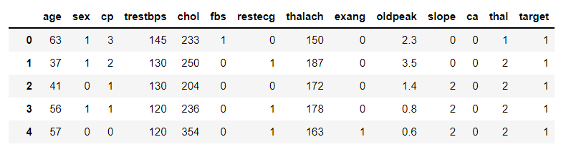
Data Observation
In this dataset, there are a total of 13 features and 1 target variable. Also, there are no missing values so we don’t need to take care of any null values.
There is one repeat value. For better understanding the dataset I remove this value
The maximum value of age is 77 but for chol it is 564. Thus, feature scaling must be performed on the dataset.

Slide 10
Data Processing
You can see in this dataset there are no missing value so I no need to done any operation to fix this.
The data are then classified and split into training data set and test data set which is run on various algorithms to achieve accuracy score results.
To work with this data set I split this dataset into 80% training data and 20% testing data.

Slide 11
Algorithm Use
In this I use five machine learning algorithm like Decision Tree , K-Nearest Neighbors , Naive Bayes, Support Vector Machine, Random Forest

Slide 12
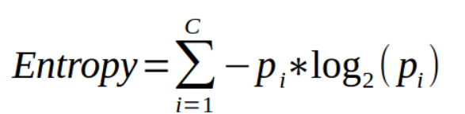
Decision Tree
Decision tree is a classification algorithm that works on categorical as well as numerical data.
Decision tree is used for creating tree-like structures.
Tree algorithm, first calculates the entropy of each and every attribute. Then the dataset is split with the help of the variables or predictors with maximum information gain or minimum entropy.
These two steps are performed recursively with the remaining attributes
An accuracy of 68.85 % has been achieved by the decision tree.

Slide 13

K-Nearest Neighbors
The K-nearest neighbors’ algorithm is a supervised classification algorithm method.
It classifies objects dependent on nearest neighbor
K-NN algorithm is simple to carry out without creating a model or making other assumptions.
It extracts the knowledge based on the samples Euclidean distance function d(xi,xj) and the majority of k-nearest neighbors.
Using KNN algorithm to predict the accuracy where K=13 then I got about 86.89% accuracy.

Slide 14
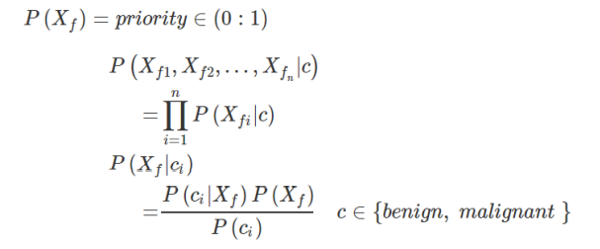
Naive Bayes
Naive Bayes classifiers are a collection of classification algorithms based on Bayes’ Theorem.
It assumes independence among predictors, i.e., the attributes or features should be not correlated to one another or should not, in anyway, be related to each other.
The model is trained through the Gaussian function with prior probability P(Xf)=priority∈ (0:1)
In This project using Naive Bayes algorithm I get approx. 86% accuracy.

Slide 15
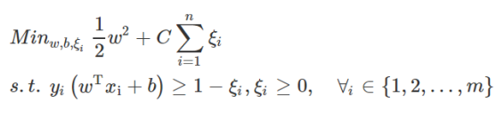
Support Vector Machine
Support Vector Machines or SVM, is one of the most popular and talked about algorithms.
SVM model represents the training data points as points in the feature space, mapped in such a way that points belonging to separate classes are segregated by a margin as wide as possible.
The test data points are then mapped into that same space and are classified based on which side of the margin they fall.
In This project using Support Vector Machines I get approx. 85.24% accuracy.

Slide 16
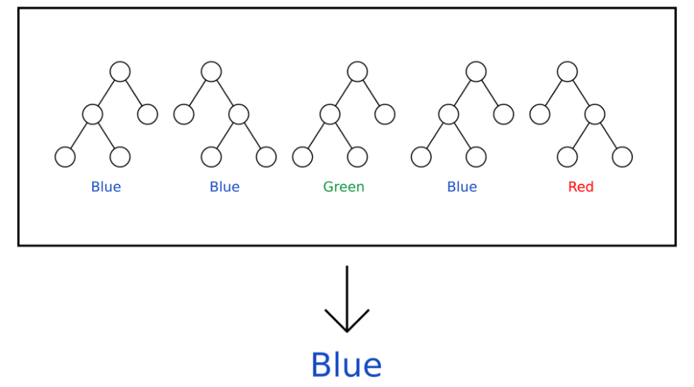
Random Forest
Random forest is a supervised learning algorithm.
This technique can be used for both regression and classification tasks but generally performs better in classification tasks.
This technique is based on the belief that a greater number of trees would converge to the right decision.

Slide 17
Comparasion Of Methodologies
 | Algorithm |  | Result
Type A | Decision Tree |  | 68.58%
Type B | KNN |  | 86.89%
Type C Naive Bayes 86%
Type D SVM 85.24%
Type E Random Forest 80.30%

Slide 18
Result And Analysis
Aim of this Project is to predict whether or not a patient will develop heart disease. And developed an web application with it
This research was done on supervised various machine learning classification techniques
Dataset was classified and split into a training set and a test set.
The different classification techniques were noted using Python Programming for training and test data sets.
Percentage accuracy scores are for different algorithms.
The highest accuracy I got from knn algorithm (89.89%)

Slide 19
Web Application
From all algorithm the best result I got from KNN (86.89% accuracy).
I implement this algorithm in my web application
Data is taken from users and then predict those data output using this model then show output (Negative, Positive) to user.
I use Django (Python base web framework), Html, CSS, JavaScript to build this web application

Slide 20
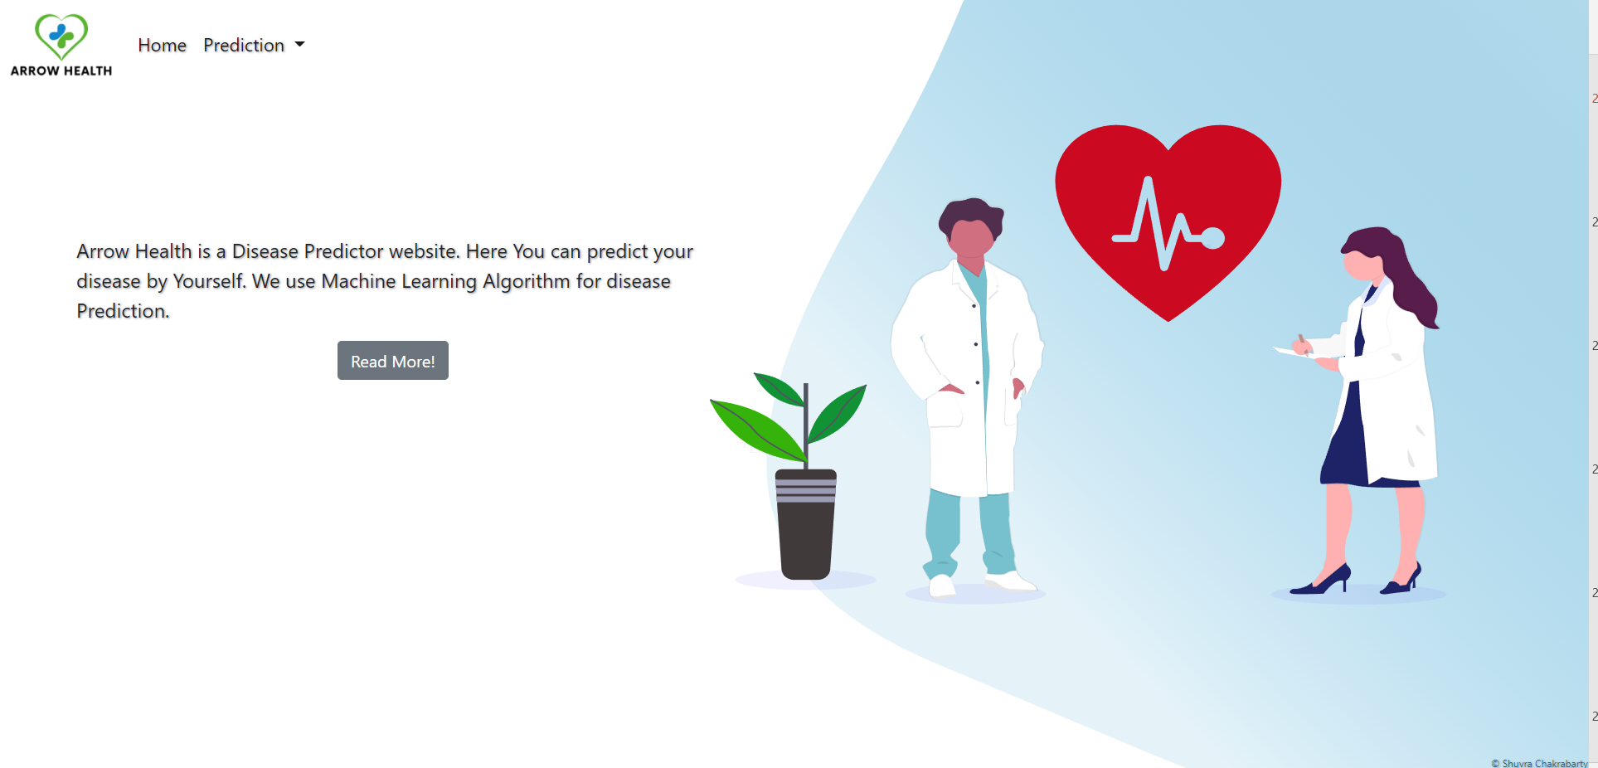
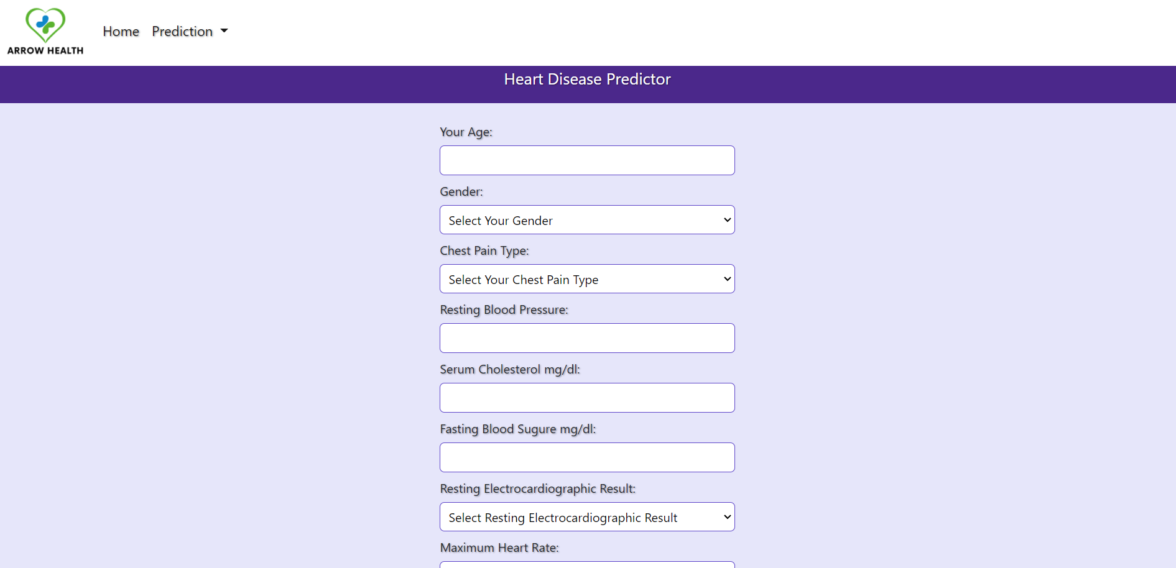
Web Application

Slide 21
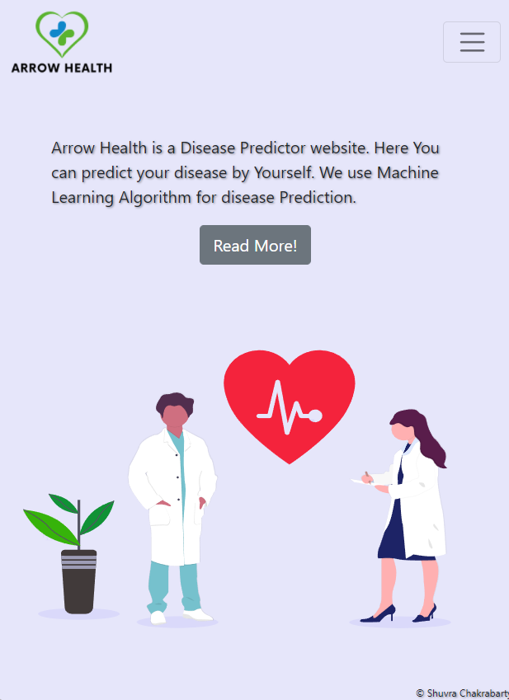
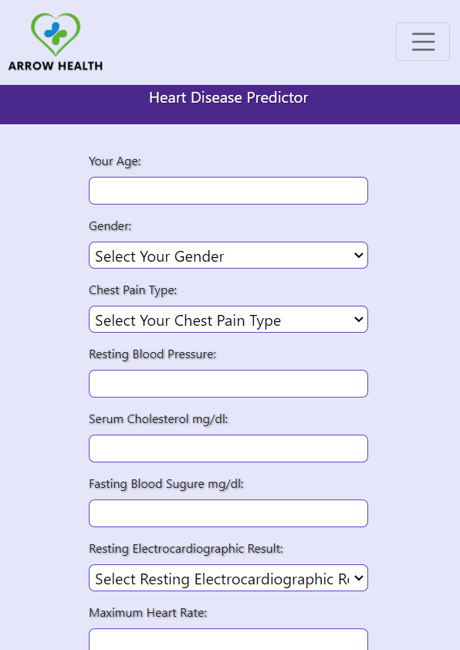
Web Application

Slide 22
Conclusion
The overall aim is to define various data mining techniques useful in effective heart disease prediction.
The purpose of this work was to compare algorithms with different performance measures using machine learning.
I applied five techniques, K-nearest neighbors, decision tree, SVM, Naïve Bayes, Random Forest
The best result is got from KNN 86.89% where k=13.
Web Application worked as expected

Slide 23

Thanks

